Slide 1

Black Pear Software
Transforming Connected Care
COMPANY SUMMARY
Unique 200+ man years successful experience
Torex: First Windows GP system >5000 GP practices
Apollo: First GP auto data extraction & reports service
Unique proven integration & Interop capability
2000+ GP Practices & 8+ million patients, growing fast
First users of FHIR, CTO Chair of HL7 UK
Founder member of INTEROpen
Award winning regional scale integration driving transformation

Slide 2











Connecting Care…Enabling Transformation
Proactive &
Preventative
Care
Productivity &
Efficiency
Urgent &
Emergency
Care
Planned
Care
Primary Care
Development
STP WORKSTREAMS
Comprehensive
Assessment
Frailty
Shared care
Records
GP Access
End of Life
SERVICES
Cross organization shared care records
Triaged cross org referrals
Context aware presentation of services
Service specific data use
Integrated electronic care plans
Proactive notifications & Alerts
Intelligent guided controlled workflows
Cross org/system Refs & Appointments
Auto real time outcomes return
Read/Write access to GP / EPRs
TRANSFORMATION CAPABILITIES
pyrusConnect
Interoperability
Read & Write
Pyrusium
Application Integration
pyrusCloud
FHIR records
Notification
services
eSP
Integrated
electronic
Shared Plans
eRA
Cross
organisation Appointments
BP PLATFORMS & TOOLKITS
CURRENT IMT

Slide 3
Electronic Shared Plans (eSP) 3 Steps to… …Collaborative Integrated Share Care
Create
Share
Update

Slide 4
Teams & eSP Solving a Common Information Challenge Example: End Of Life
Regular difficult or crisis situations for urgent & emergency care, at patient homes or hospices can and do create high risk of…
Decision confusion or uncertainty
Time wasted ‘finding out’
Decisions not always in accordance with patient preferences & wishes
‘If in doubt’ action =
Avoidable episodes and admissions
Patients not dying where they wish to
Right people/next of kin/carers informed?

Slide 5
Example: EoL Information Challenge
Patient and/or carers contact NHS at 3am…
Are all services aware Patient is EoL and has an EPaCCs record?
Can the relevant EoL information be accessed as part of triage?
Confidence the EoL information they view is the correct status?
Is all the information needed available in the right format?
Can HCP’s update live the Patients EPaCCs record?
Do updates notify live relevant stakeholders in care of changes?
Will changes live update the GP including any agreed codes?

Slide 6










CCG C
CCG B
CCG A
eSP
eSP
User defined Care Plans
presented in context of patient record in GP system current
eSP
User defined Care Plans
presented in context of current patient record in GP system
User defined Care Plans
presented in context of current patient record in GP system
Care Plans
Ambulance
Contextual two way
Conversation across
services and systems.
Community
111/OOH
Acute
IDCR
service
Hospices
Clinical Hubs
Social Care
GP

Slide 7

Integrated Shared Care Plan Service
IDCR
service
Patient Demographic Service (PDS)
Contextual access
Read & Write
Review & live update with
new codes
Live Read & Write between eSP & GP Systems
111/OOH
Plan published to eSP cloud service
Live notification of new, updated
or closed eSP records
eSP
Live changes auto
notified to GP
GP
Live notification of new, updated
or closed eSP records
Live changes
direct to EPaCCs record
Ambulance
Contextual access & presentation
of eSP or other web apps
Service defined data exchange
Live read & write with web app/forms
FHIR & Care Connect End Points
eSP record auto filed into GP record
Codes, free text & documents
Available Capabilities….
Live
Notifications
Contextual
Launch
Live Update
GP data
Live View & Update
Live update
Notifications
Create anytime anywhere
EPaCCs access…
Data exchange
Click through
Stand alone
Community
Hospital
Hospice
Social Care
© Black Pear Software 2019

Slide 8
Integration with Cleric CAD and clinical system
to automatically notify and flag records when:
new EPaCCs created or
current EPaCCs records updated

Slide 9
EPaCCs Record in under 60s…what else?
Ambulance service - Live notification & updates
Hospice - live access, update or create
Community – Access, update or create, EMIS sharing
Acutes - Live notification, contextual access, data exchange
IUC - Live alert & access in standard workflow
GP – Awareness, available as part of GP record
Auto create for GPs
Live notifications
Access:
In source system
Contextual Launch
Stand alone
Live updates
Create anytime, anywhere
Share across and beyond STP

Slide 11
Our Integrated Shared Care Principles
Service Led - driven by solving real world clinical and operational challenges.
Information sharing …
Access what you need when you need it
Only use what is needed for the role of the person providing care
View and record what you need, when and where you need to do it
Share what is clinically relevant or necessary with others
Smart, real time sharing with multiple source systems
Built on National Standards
Guided by National Guidelines
Tailored and sustainable to local service and patient needs
System to system or App, enhance & extend, supports systems of choice

Slide 12
Example: CASTLE Register Objectives
Single source of truth, consistent data set & information
Shared across services and systems, information exchanged ‘in and out’
Integrate with workflow across different providers & systems
Live incremental growing EoL record (clinical content creation)
Guided intelligent workflow, clear interactive presentation of EoL data set
Platform for enabling integrated shared care

Slide 13
Meeting the EoL Information Challenge
Patient and/or carer contacts NHS at 3am…
All services aware patient is EoL and their associated wishes
Call handlers and clinicians access live EoL information as part of triage
Certainty of latest status with patient history
All information to hand for best EoL point of care decisions
Update live EoL information from encounter
Live notification of changes to relevant stakeholders in care
Live update to GP for those changes they want/need to know.
Commissioned for >600 Practices
and associated:
Acute Trusts
Community Trusts
Urgent Care
Hospices
Social
6m patients

Slide 14
Feedback from GPs and their teams
The system is easy to use, simple and intuitive
We've certainly being using the Castle Register very proactively and adding any new EOLC patient on. We've found is immensely helpful to have one system that allows us to communicate with OOH and WMAS helpful and time saving. We started getting some of the WMAS forms back which helped us feel reassured that the information has got through

Slide 15
What about the importance to patients and their families?
"Certainly from a patient perspective when we've talked about the register the response has been very positive and they are grateful to be on a register that reaches across primary care boundaries."
"Patients have told us at when the ambulance service have arrived they already knew the primary diagnosis and DNACPR decision which helped both the patients and the paramedics."
"One bereaved relative said to me "you doing that form really helped and made us feel both safer"

Slide 16

Who We Are
The Team
25 Years Experience in clinical systems and health informatics
Clinically Led with focus on the use case not the technology
Work to National Standards and national guidelines
The Credentials
Founder Member of INTERopen
CTO is chair of HL7 UK
Committed to opensource and open standards
Focus Of Activity
25%
Bespoke
and
3rd Party
75%
NHS Solutions
eRA and eSP

Slide 17
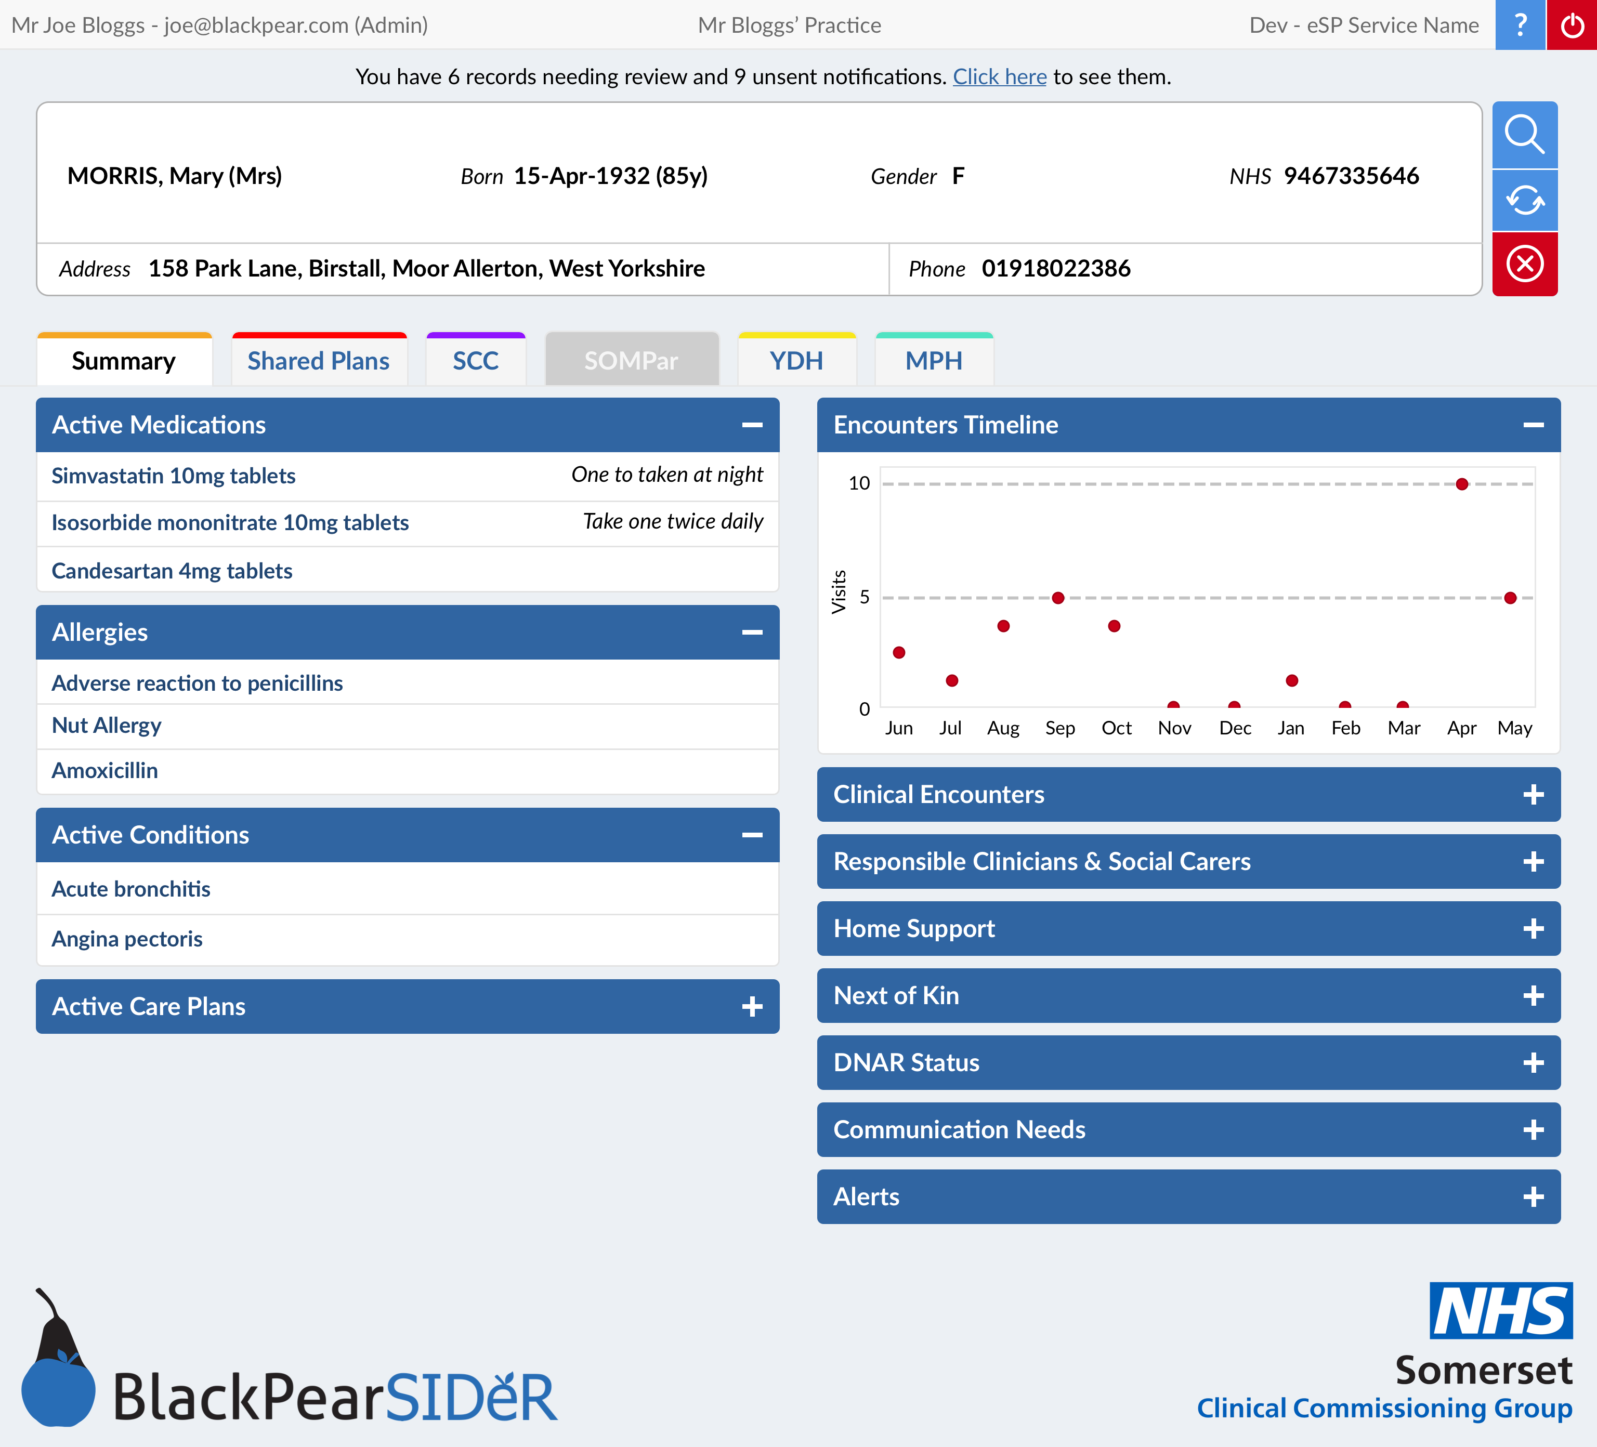
eSP Shared Care Record
Live on Demand
Direct from Source Systems

Slide 18

Questions ?
Integrating Services
Connecting Providers

Slide 19
Copyright Notice
© Copyright
Copyright and other intellectual property rights contained in this presentation are owned by Black Pear Software Ltd.
No part of the layout, design or freestanding text may be reproduced in any material form (including photocopying
or storing it in any medium by electronic means and whether or not transiently or incidentally to some other use
of this publication) without the written permission of Black Pear Software Ltd except in accordance with the
provisions of the Copyright, Designs and Patents Act 1988.
Applications for written permission to reproduce any part of this publication should be addressed to Black Pear
Software Ltd. Bartlam House, Shrawley, Worcester, WR6 6TP or alternatively can be emailed to; info@blackpear.com

